Slide 1
BoC Copilot Studio Technology Zones
PAG Presentation of Copilot Studio Technology Zones implementation

Slide 2
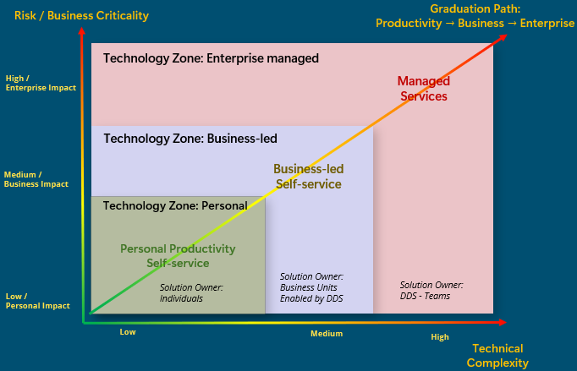
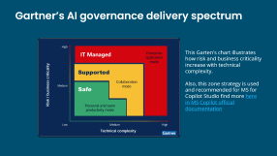
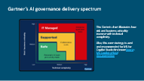
DDS Platforms as a Self-Service (PaaSS).
A Technology Zone is a set of mandatory technical capabilities, controls, and configuration policies enforced by the platform to support a given risk and complexity level.
Answers ->: “What must the platform technically enforce?”
A Service Model defines how the service is consumed and operated
Answers: “What should users expect and who owns what?”
👉 Key rule: A Service Model runs on a Technology Zone but cannot override its constraints.
Click to zoom
Notes:
Enterprise application mode is “IT Managed,” with high risk and complexity. IT oversees agent deployment, ensuring compliance and security for mission-critical solutions.

Slide 3
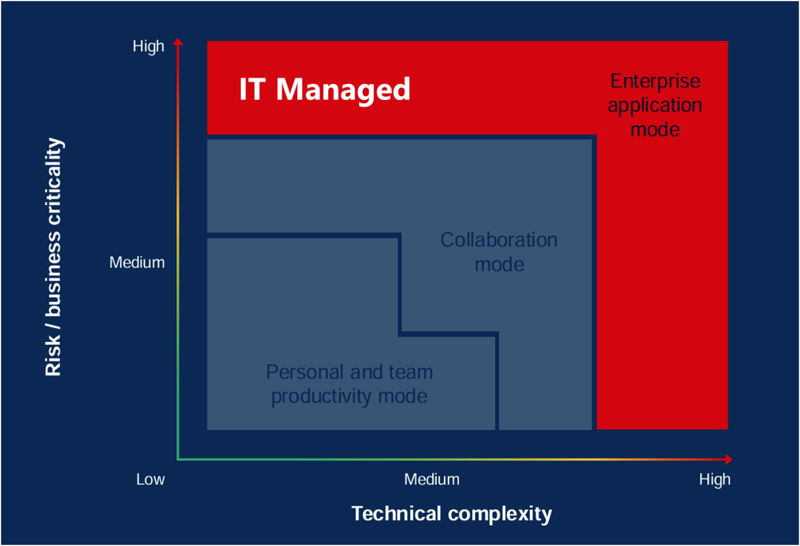
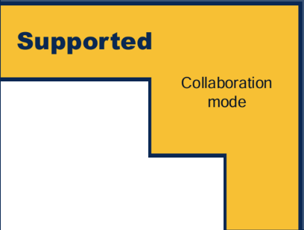
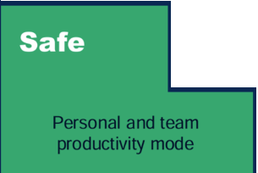

Gartner’s AI governance delivery spectrum
This Garten's chart illustrates how risk and business criticality increase with technical complexity.
Also, this zone strategy is used and recommended for MS for Copilot Studio find more here in MS Copilot official documentation

Slide 4


BoC AI Platform as a Self-Service (AI-PaSS) for AI Agents
Business-led Self-serve
Service Model
Teams & Departments AI Solutions
For every Business Unit
Simple Business projects
Advanced Business projects
Technology Zone
Technology Zone:
Business Agents
AI Agent Type
Declarative Agents (DA)
Custom AI Engine Agents (CEA)
AI Platforms
Copilot Studio “Lite”
Copilot Studio “Full”
Coding Complexity
AI Templates
AI No code
AI Low code
AI Pro code

Slide 5







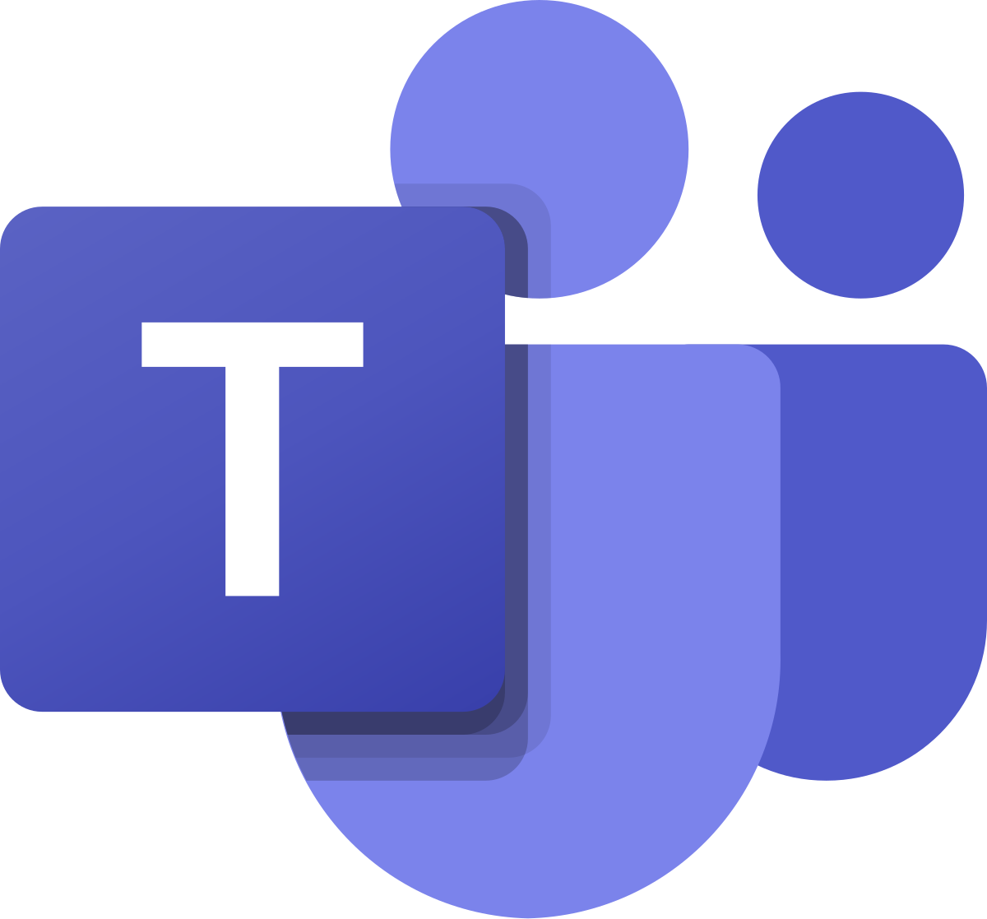

Business-led AI Technology Zone - COPILOT STUDIO
Production Compliance Assessment
Business Teams
SLA Contract
UAT Test Evidence
Cyber Pattern Compliance
Data Validation
1
Self-Readiness Assessment
8
6
7
DEV-UAT
UAT-PROD
11
PAG Presentation
User Membership Mgmt.
2
Onboarding
Approval
Solution
1.2
Solution
1.1
Solution
1.0
3
Client Contract
Prod Platforms
4
5
Business
AI Dev Environment
Business
AI UAT Environment
Business
AI PRODUCTION Environment
Access Group
Env Roles Assignment
Consumers
10
UAT Testing Platforms
9
Env Settings and DLP

Slide 6


BoC AI Platform as a Self-Service (AI-PaSS) for AI Agents
Managed Services
Enterprise sensitive AI Solutions
For AI developers
Business-led Self-serve
Advanced Enterprise level projects
Teams & Departments AI Solutions
For every Business Unit
Personal Productivity
Simple Business projects
Advanced Business projects
Service Model
Personal AI solutions
For every employee
Technology Zone
Technology Zone:
Personal & Limited scope Agents
Technology Zone:
Business Agents
Technology Zone:
Crucial Enterprise Agents
Pre-Built Agents (PBA)
Declarative Agents (DA)
Custom AI Engine Agents (CEA)
AI Agent Type
AI Platforms
(examples of some platforms)
M365 Copilot Service
Copilot Studio “Lite”
Copilot Studio “Full”
Copilot Studio “Full”
Azure AI Foundry
Coding Complexity
AI Templates
AI No code
AI Low code
AI Pro code

